Slide 1
Welcome to our presentation

Slide 2
Presentation on Online Examination System

Slide 3
Group members
MD Abu Noman Majumdar
ID:1208002
MD Borhan Uddin
ID:1208003

Slide 4
Introduction to Online Examination System
Online Examination System is an on-line test simulator is to take online examination, test in an efficient manner and no time wasting for manually checking of the test paper. The main objective of this web based online examination system is to efficiently evaluate the student thoroughly through a fully automated system that not only saves lot of time but also gives fast and accurate results. For students they give papers according to their convenience from any location by using internet and time and there is no need of using extra thing like paper, pen etc.

Slide 5
DISADVANTAGES OF PRESENT WORKING SYSTEM:
Time Consuming for creating question paper
Time to check right and wrong answers
Calculation of Marks
Human error
Limitation of no of student can give examination at a time
Require teacher to monitor exam center
Student needs to come exam center for giving test

Slide 6
Purpose of the project:
Complete Automation, no manual intervention in whole process of examination
No geographical boundary
Student can give examination from anywhere of the world by 24X7
100% accuracy in result calculation
Randomization of question set

Slide 7
Software requirements:
PHP
MySQL Server
NetBeans / FrontPage / NotePad

Slide 8
Hardware requirements:
Intel 3.0 GHZ or higher processor
2 GB RAM
10 GB HDD Space

Slide 9
Module Description:
Make Question: Allow the administrator to make questionnaire with exam date and time.
Result: Allow administrator to see the result of given exam.
Give Exam: Here student choose a particular subject to provide exam with multiple choice question. A digital clock shows what’s time left to terminate exam
Student Signup: Here student provide their name , id , email id , their image and password to log in .

Slide 10
Future scope of the project:
Linking of other online site
Include graphical and media file as question and answers
Use of JQuery for more smooth interface

Slide 11
Feasibility Study

Slide 12
Economically Feasibility:
The system being developed is economic with respect to University’s point of view. It is cost effective in the sense that has eliminated the paper work completely.

Slide 13
Technical feasibility:
The technical requirement for the system is economical. It does not use any other additional hardware. So any system with the minimum hardware will run this software very smoothly. But considering the modern hardware the system is way too easy to handle

Slide 14
Behavioral Feasibility:
The system working is quite easy to use and learn due to its simple but attractive interface. User requires no special training for operating the system.
Anyone familiar with simple interfacing system can use this software very effectively.

Slide 15

Data Table
Admin login

Slide 16
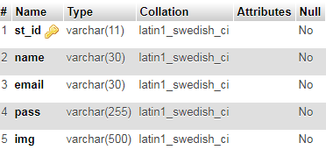
Student registration

Slide 17
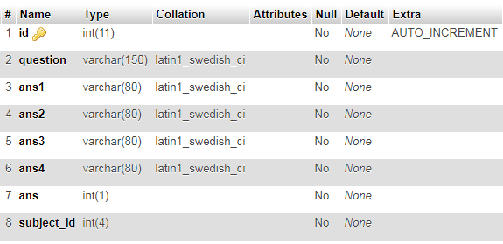
Question table

Slide 18

Subject table

Slide 19
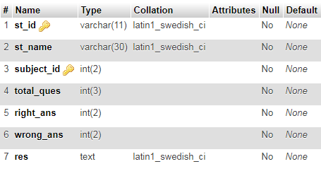
Result table

Slide 20
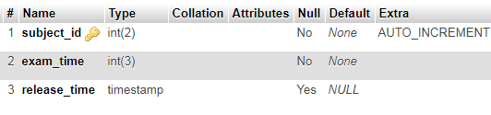
Date and time table

Slide 21
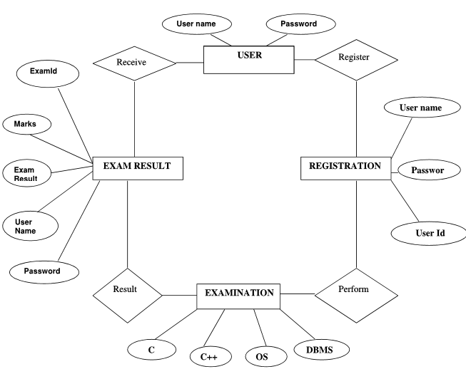
ER Diagram

Slide 22
Screenshot

Slide 23
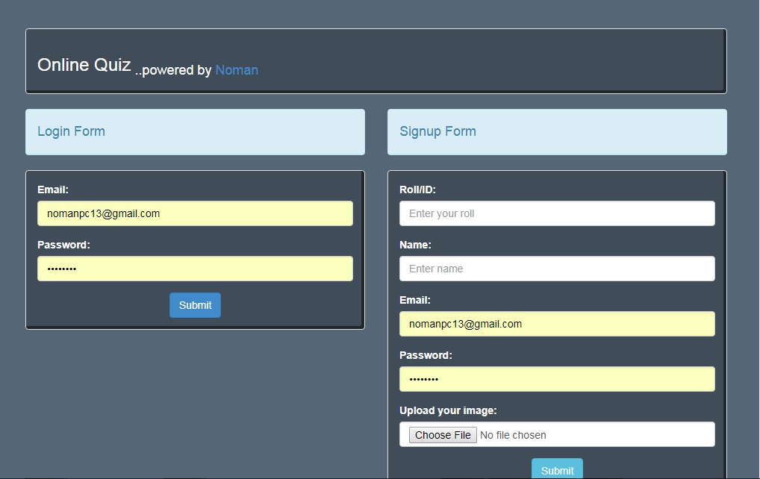
Sign up and log in

Slide 24
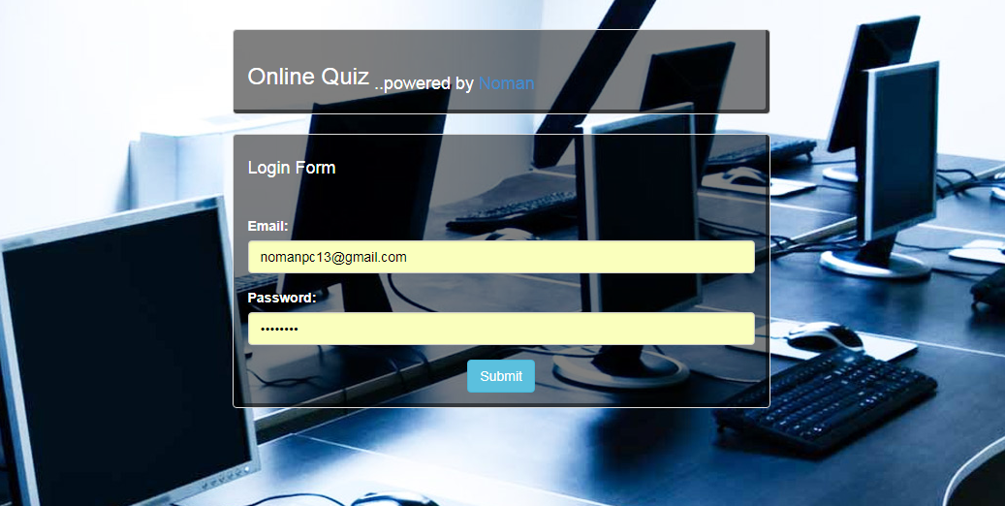
Admin log in

Slide 25
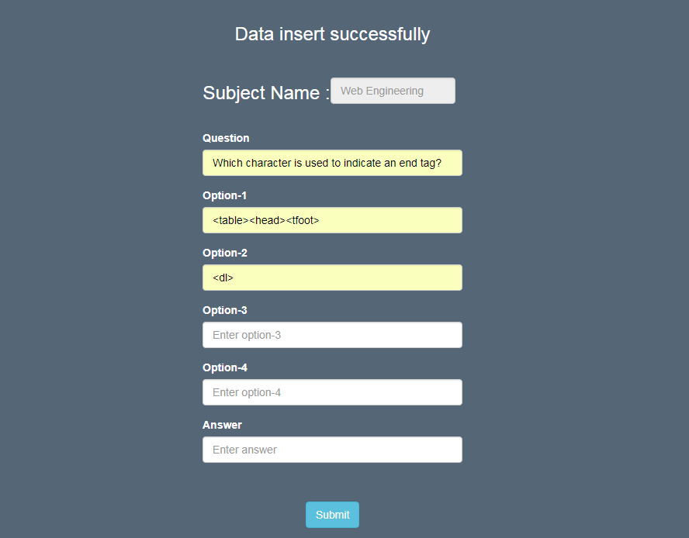
Make question

Slide 26
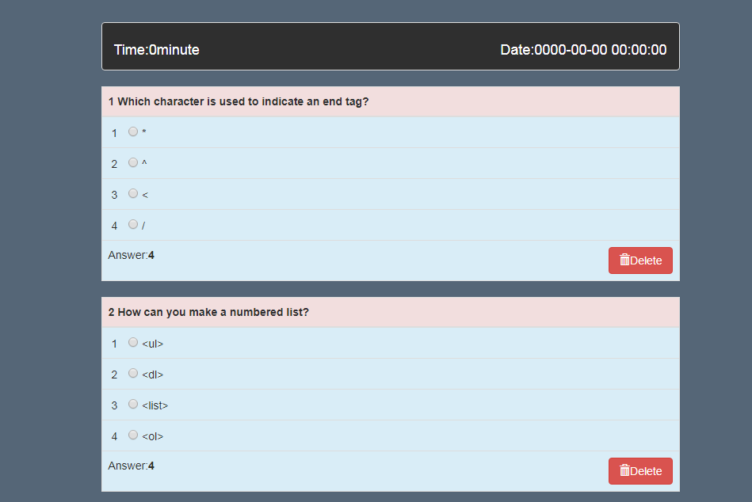
Review question

Slide 27
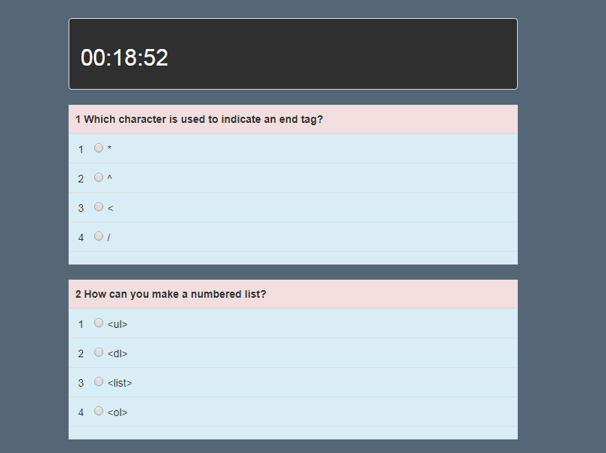
Taking exam

Slide 28
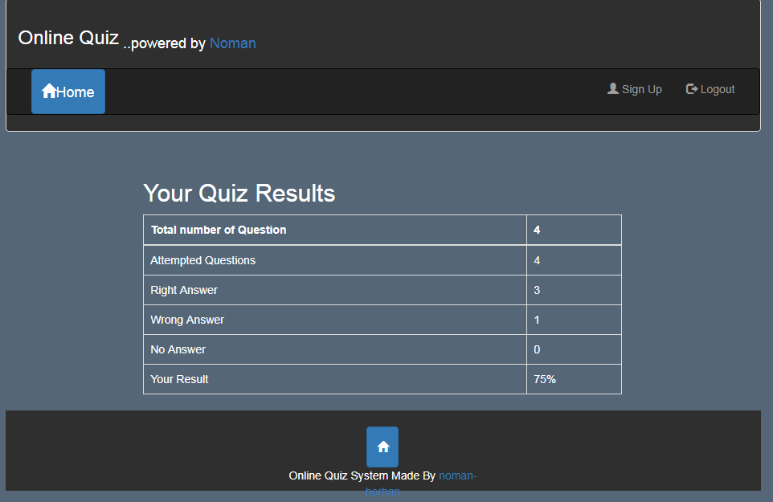
Immediate result after exam

Slide 29
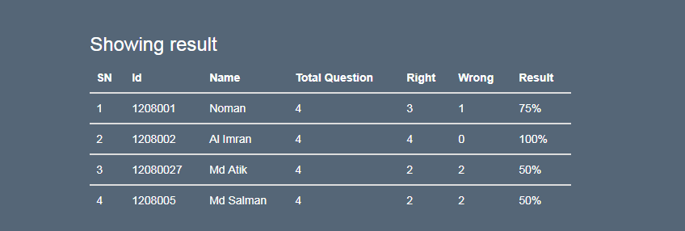
Recorded result

Slide 30
Thank You

